Slide 1
Technical English for Computer Science
Week 6
Dr. Nur Banu OĞUR

Slide 2
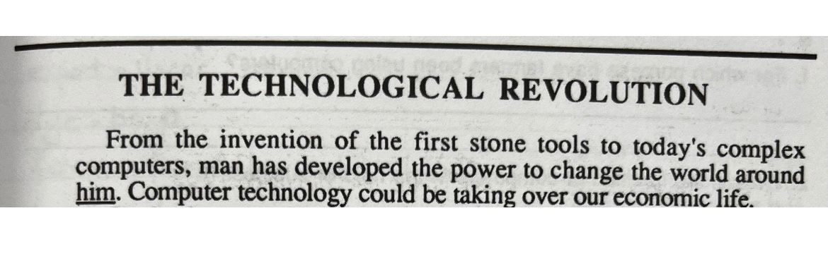

Slide 3
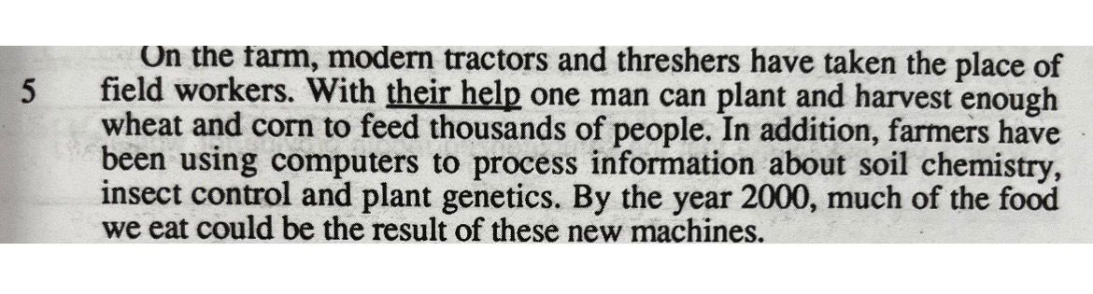

Slide 4
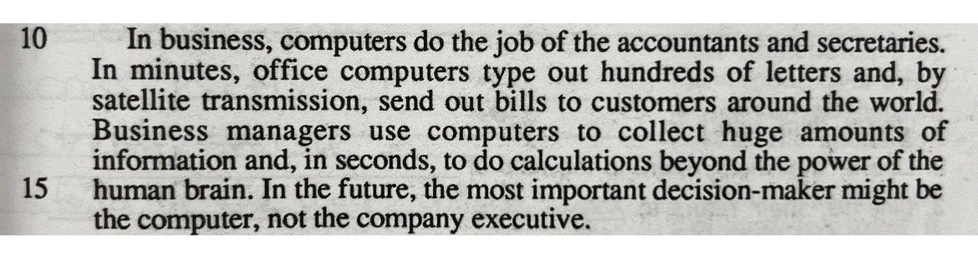

Slide 5
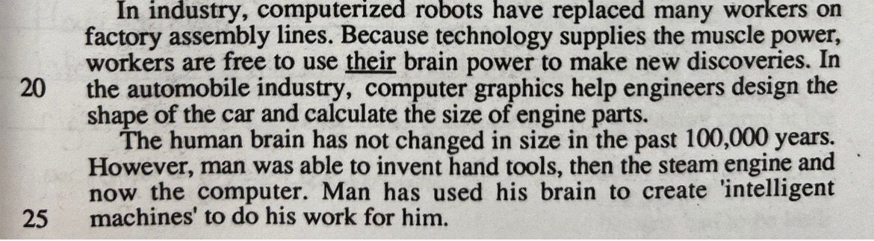

Slide 6
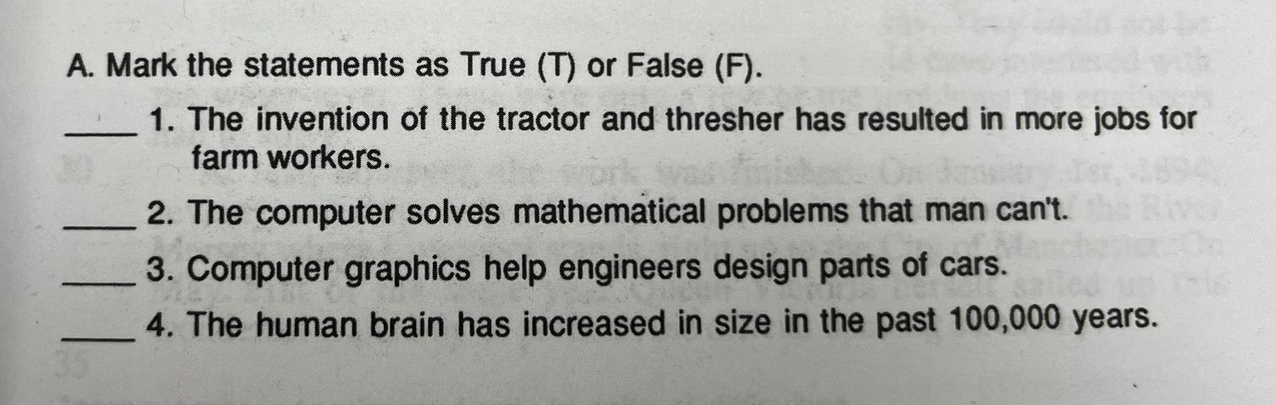

Slide 7
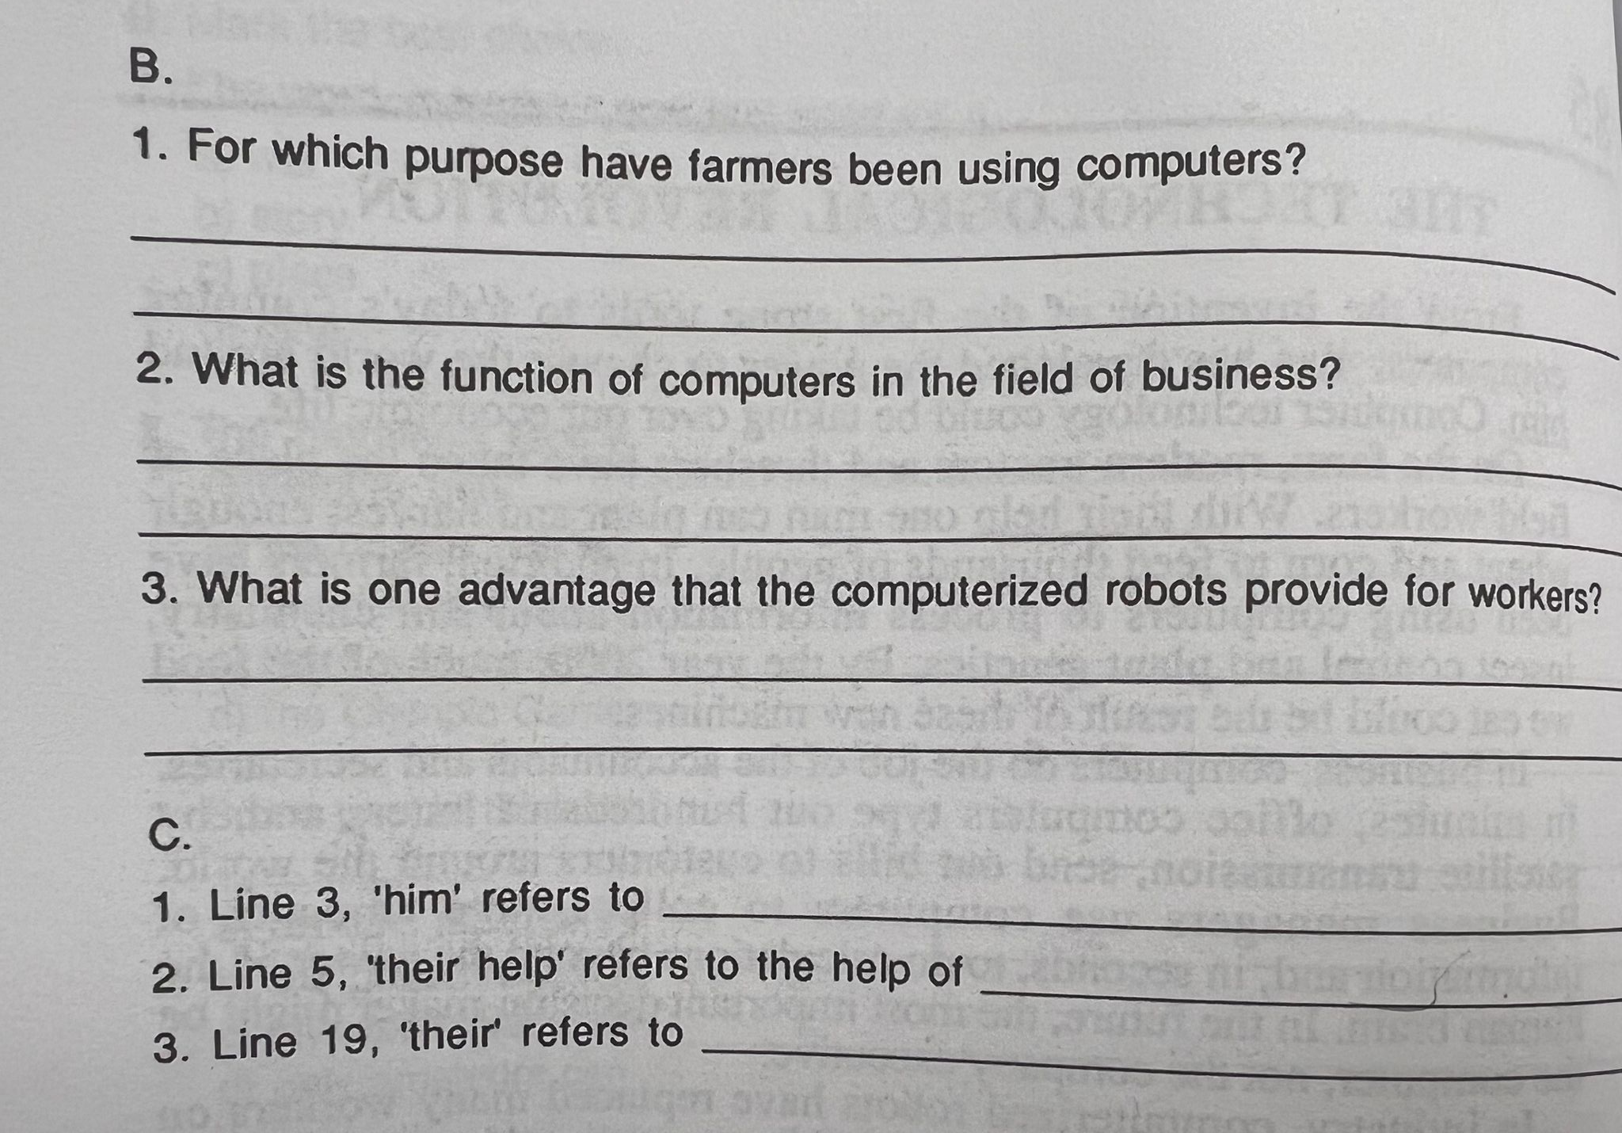

Slide 8
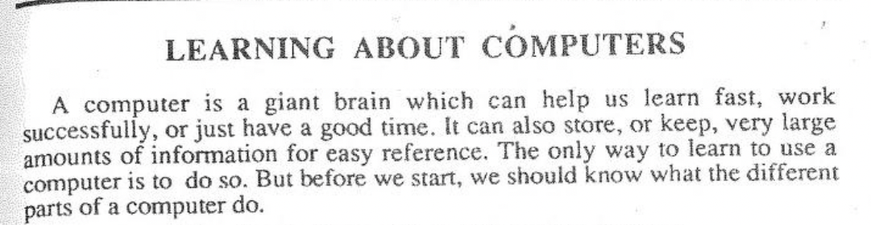

Slide 9
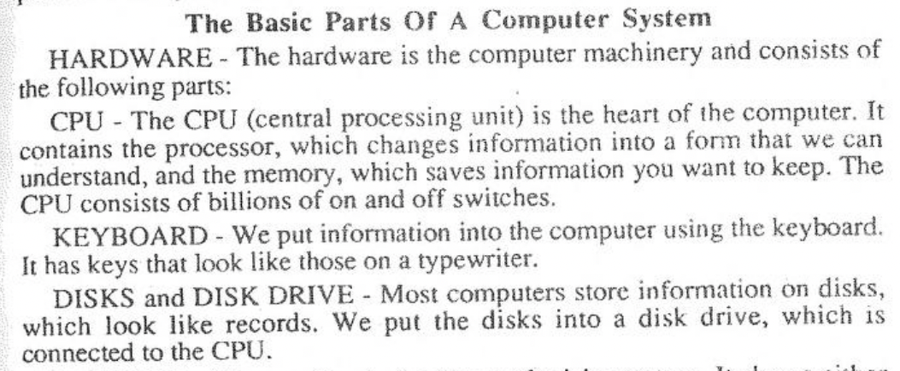

Slide 10
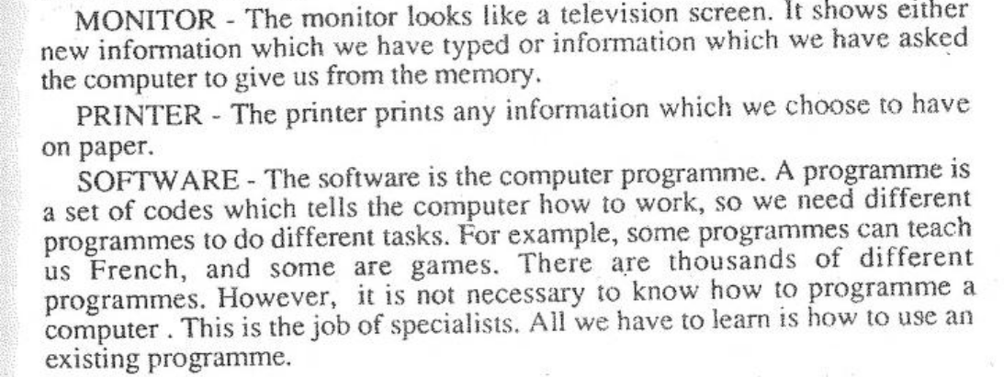

Slide 11
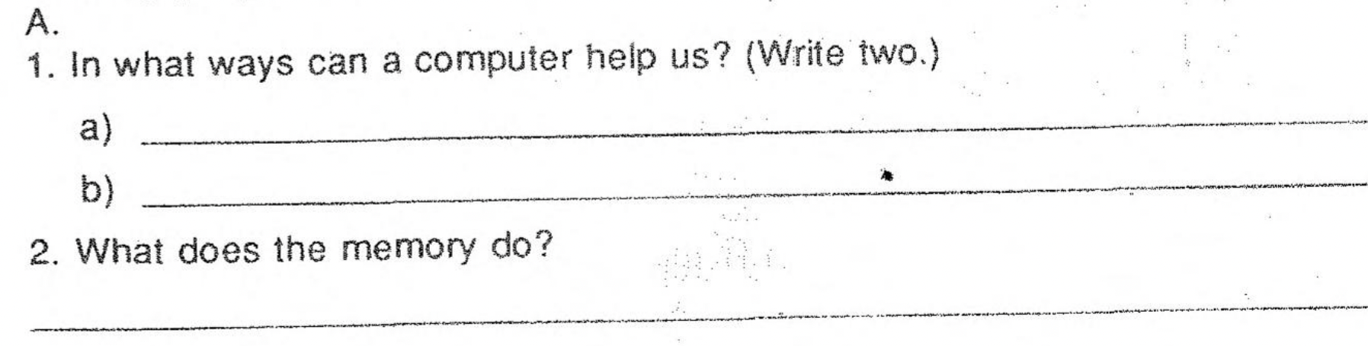

Slide 12
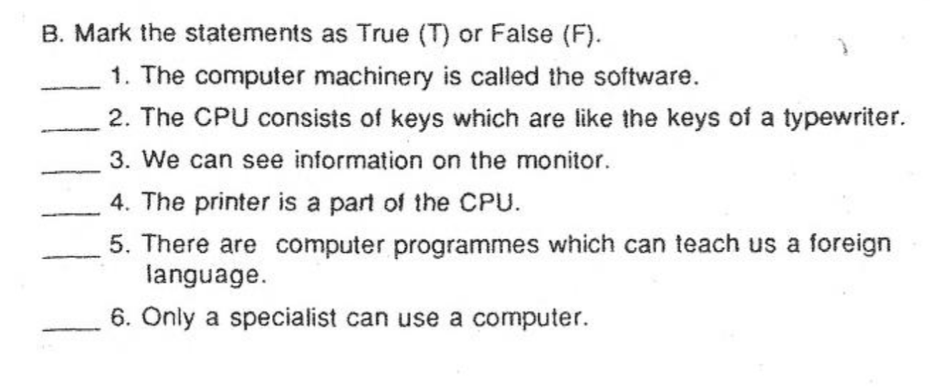

Slide 13
Writing
What do you think was the most productive and enjoyable course you attended during your computer engineering education? Why is that? If there is no such course, which course would you prefer to be added to the curriculum?

